Slide 1
COLUMBIA ANALYTICS PROJECT:
Vespucio Free-Flow Toll Collection
Michelle Peng
Kris Chen
Vidhi Agrawal
Howard Yu
Raphael Barthes

Slide 2
TABLE OF CONTENTS
Part 1: Project Overview
1.1 Project Background
1.2 Goals and Progress
1.3 Data Sources
Part 2: Macroeconomic Correlation Analysis
2.1 Univariate Correlation
2.1.1 General Economic Conditions
2.1.2 Inflation
2.1.3 Household Conditions
2.1.4 Urban Transportation
2.2 Multivariate Correlation
Part 3. Predictive Model: Data EDA
3.1 Vespucio Data EDA
3.2 Equifax Data EDA

Slide 3
Part 1: Project Overview
1.1 Project Background
Problem Overview
Toll Evasion Increase: Urban toll road systems, particularly in Chile, face difficulties with efficient toll collection. There has been a notable rise in toll evasion rates, with default rates escalating from 4% to 20% post-pandemic.Previous strategies to combat this issue have proven insufficient, resulting in potential decreased in the bottom-line.
Lack of Advanced Data Analysis & Need for Predictive Insights: There has been significant gap in using data-driven methods to predict toll payment behaviors, which is essential for anticipatory strategies in toll collection and management.
Project Goal and Objectives
Macroeconomic Analysis: Examining the impact of economic trends on payment delays to aid in strategic negotiations regarding fixed toll pricing.
Predictive Model Development: To forecast likelihood of payment default and estimating payment timings for each consumer, and identify optimal collection agency involvement.
Expected Impact
Re-negotiated Toll Rates: To negotiate fixed toll-rates with involved government agencies.
Improved Revenue Efficiency: Enhance toll revenue collection by preempting and managing defaults effectively.
Sustainable System Maintenance: Support the sustainability of the toll road system through a data-informed approach that can be used following our team’s involvement in the project.

Slide 4
Part 1: Project Overview
1.2 Goals and Progress
Our goals are structured around two primary focus areas: Macroeconomic Correlation Analysis and Predictive Modeling.
Macroeconomic Correlation Analysis
Objective: To assess impacts of various macroeconomic indicators on defaults rates.
Macroeconomic Indicators:
Classified into 4 categories: Overall Economic Health, Inflation, Household conditions, and Urban Transportation
Sourced from organizations including FRED, the World Bank, IMF, Central Bank of Chile,and the National Statistics Institute of Chile.
Data Sources: Detailed in following slide.
Methodology:
Univariate Regression (OLS): Analyzing individual macroeconomic indicators against % default rate.
Multivariate Regression (OLS): Combining significant indicators from each category to explain default rates.
Predictive Model
Objective: To forecast individual default likelihood and payment timing.
Current Phase: Initial Exploratory Data Analysis (EDA)
Vespucio Dataset:
Comes from the Vespucio data project, advised by Ardian’s IT and Data Science team.
Contains 482 million transactions with automated data processing and updates,
Includes detailed information on customer characteristics, behaviors, and payment details.
Equifax Dataset:
Comes from a joint venture between Equifax ID Patrol™ and the Chilean Government,
Includes detailed information on consumer credit scores.

Slide 5
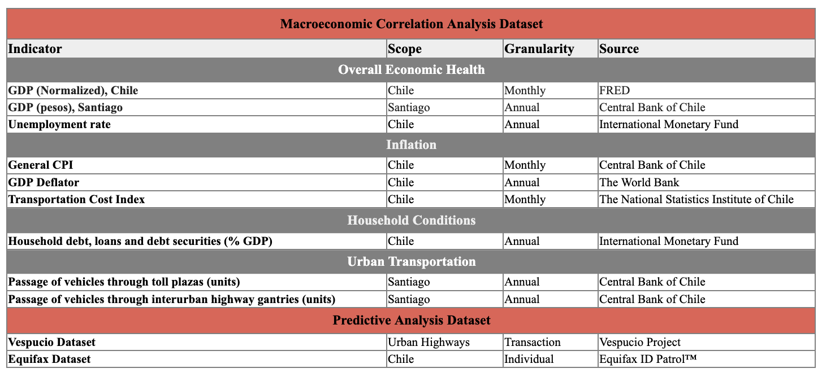
Part 1: Project Overview
1.3 Data sources

Slide 6
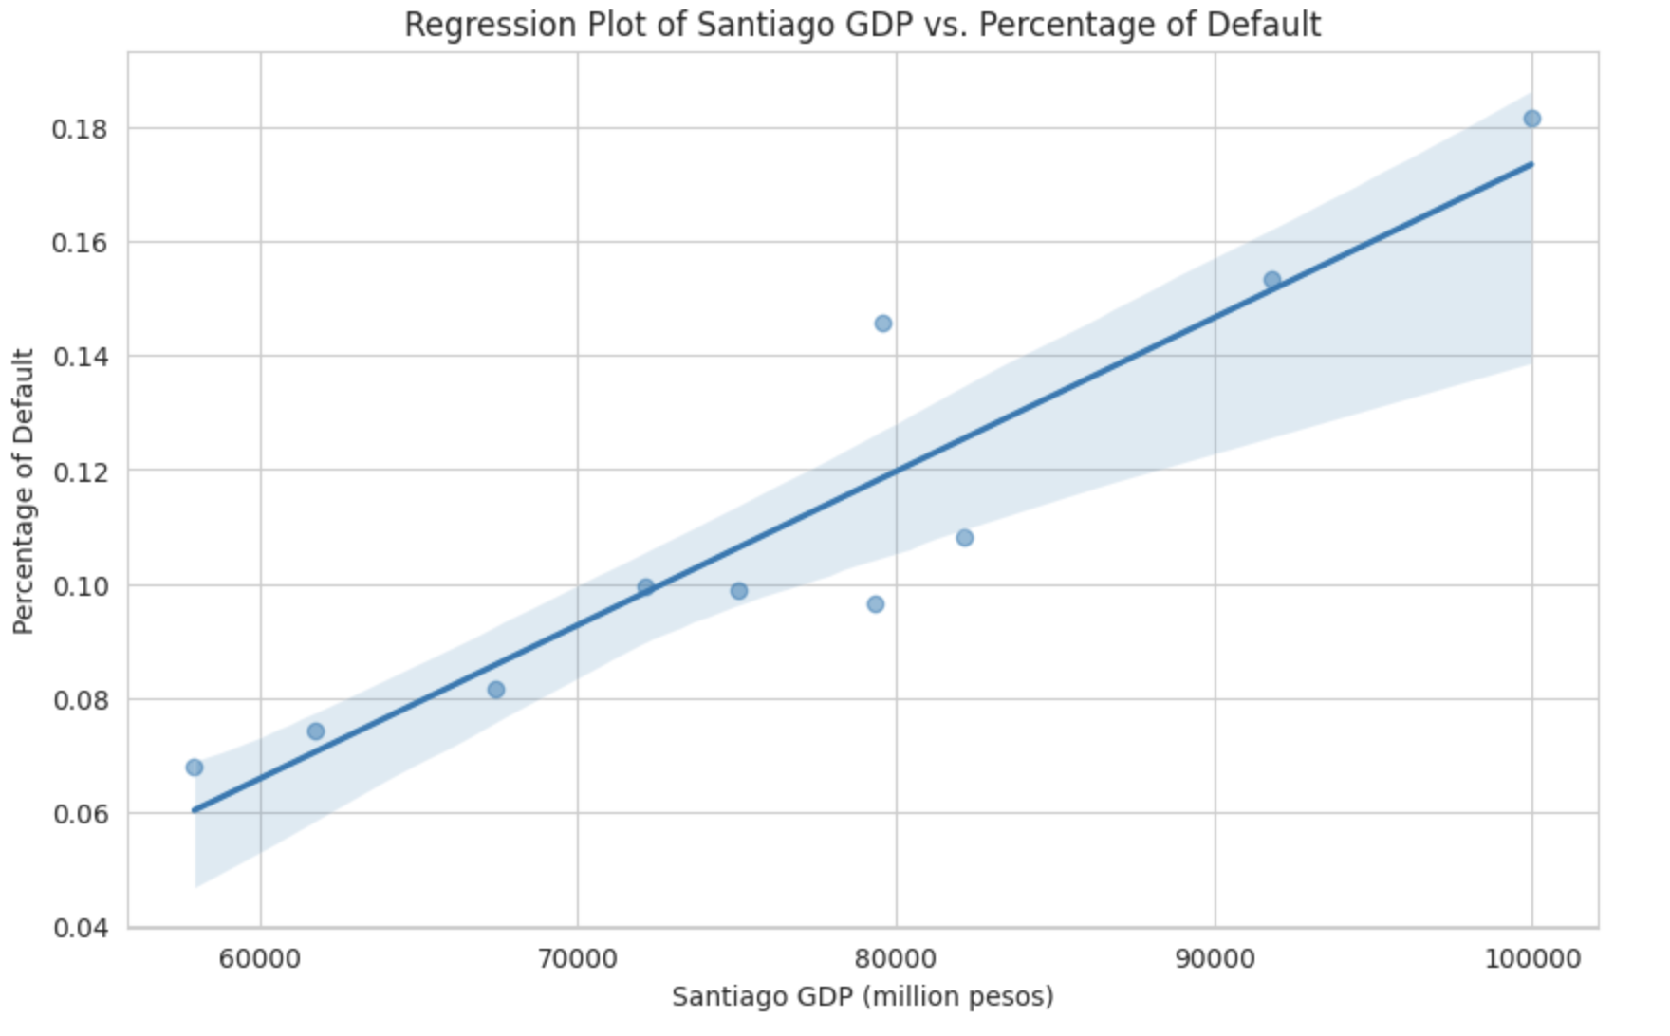
Part 2: Macroeconomic Correlation Analysis
2.1 Univariate Correlation
Models:
Dependent Variable: Default Percentage
Model: Ordinary Least Squares (OLS) Regression
2.1.1 Overall Economic Health
Independent Variables | Chile Normalized GDP (monthly) | Santiago GDP (yearly) | Unemployment Rate (yearly)
Coefficients | Const: 0.9843 (P>|t|=0.000) GDP: -0.0090 (P>|t|=0.000) | Const: -0.0956 (P>|t|=0.011) GDP: 2.691e-06 (P>|t|=0.000) | Const: -0.1160 (P>|t|=0.585) Rate: 0.0325 (P>|t|=0.232)
Regression Results | R-squared = 0.200 F-statistic = 47.32 | R-squared = 0.865 F-statistic = 51.17 | R-squared = 0.083 F-statistic = 1.539
Diagnostic Tests | Durbin-Watson = 0.251 Jarque-Bera = 13.67 Kurtosis = 3.569 | Durbin-Watson = 1.781 Jarque-Bera = 0.128 Kurtosis = 2.925 | Durbin-Watson = 0.679 Jarque-Bera = 100.258 Kurtosis = 12.494
Pearson Coefficient | -0.447 | 0.930 | 0.288
Coefficient Interpretation:
Constant: Base level of defaults are zero. Statistically significant (P>|t|=0.011)
Santiago GDP: marginal increase in default rate for each increase of one million pesos in GDP. Statistically significant (P>|t|=0.000)
Regression Results:
Strong Model Fit: High R-squared indicates high explanatory power
Model Significance: High F-statistics
Strong Linear Correlation: Pearson Correlation Coefficient close 1
Diagnostic Tests:
Low Autocorrelation: Durbin-Watson close to 2 - there is no strong evidence of autocorrelation in the residuals of the model
Normally Distributed Residuals: small Jarque-Bera score and Kurtosis close to 3 suggest that the residuals do not significantly deviate from a normality
Notes:
Constant: not meaningful -

Slide 7
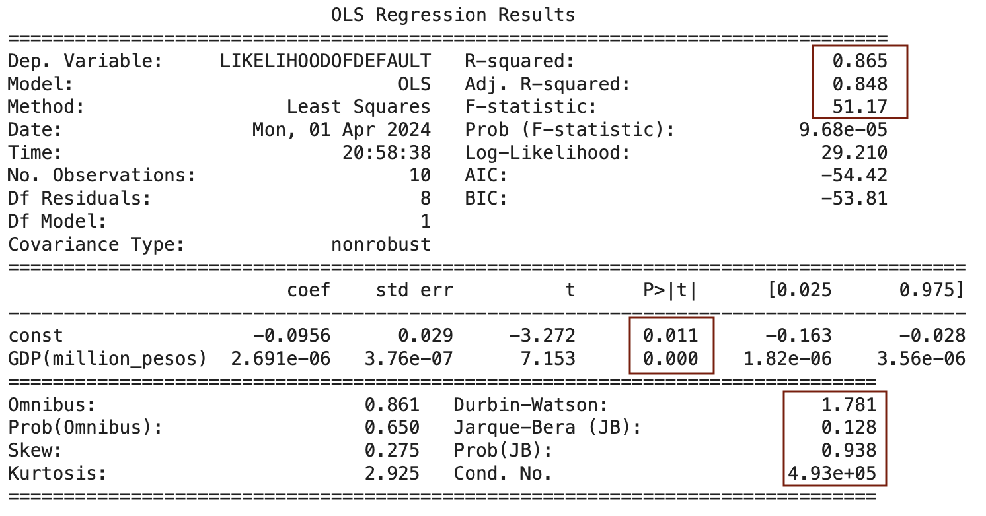
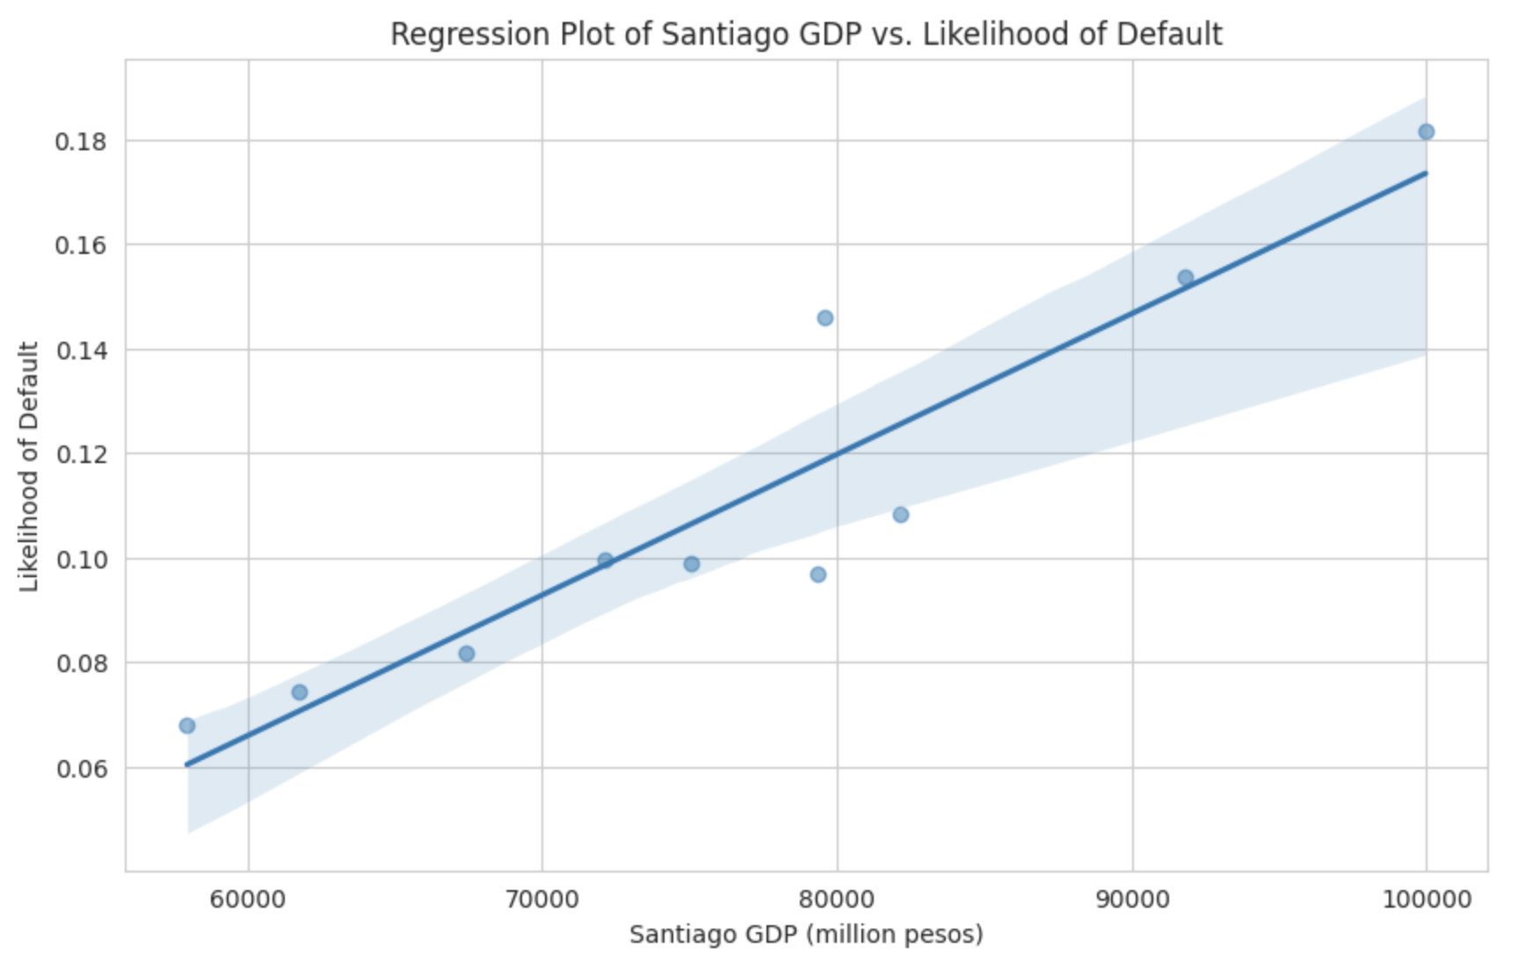
Part 2: Macroeconomic Correlation Analysis
2.2 Univariate Correlation
2.2.1 Overall Economic Health (Chile Normalized GDP, Santiago GDP, Unemployment Rate)
Santiago GDP Model Variables:
Dependent Variable: Yearly Default Percentage
Independent Variables: Santiago GDP, in million pesos
Model: Ordinary Least Squares (OLS) Regression
Regression Results:
Strong Model Fit: R^2 of 0.865 indicates high explanatory power
Model Significance: F-statistics of 51.17 indicates the model is statistically significant, confirmed by low Prob(F-Statistics): 9.68e-05
Strong Linear Relationship: Pearson Correlation Coefficient (0.93)
Coefficient Interpretation:
Constant: Base level of defaults are zero, so -0.0956 is not meaningful. Statistically significant (P>|t|=0.011)
GDP(million_pesos): marginal increase in rates of default with increasing GDP of Santiago. Statistically significant (P>|t|=0.000)
Diagnostic Tests:
Low Autocorrelation: Durbin-Watson of 1.787 suggests there is no strong evidence of autocorrelation in the residuals of the model
Normally Distributed Residuals: Jarque-Bera of 0.128, Prob(JB) of 0.938 and Kurtosis of 2.925 all suggest that the residuals do not significantly deviate from a normality
High Multicollinearity Concern: condition number of 4.93e+05 signifies a significant issue with multicollinearity
Notes:
Constant: not meaningful -

Slide 8
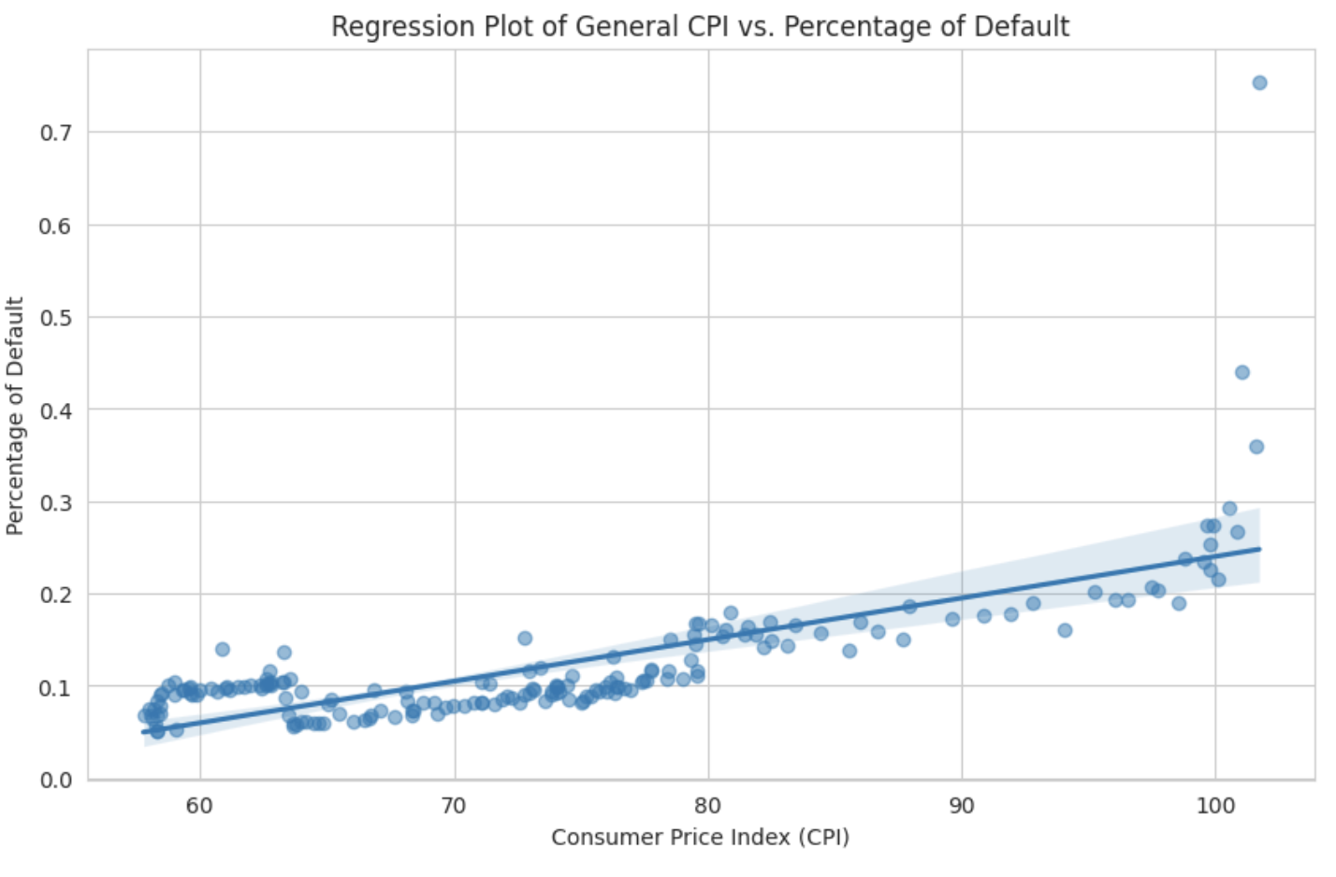
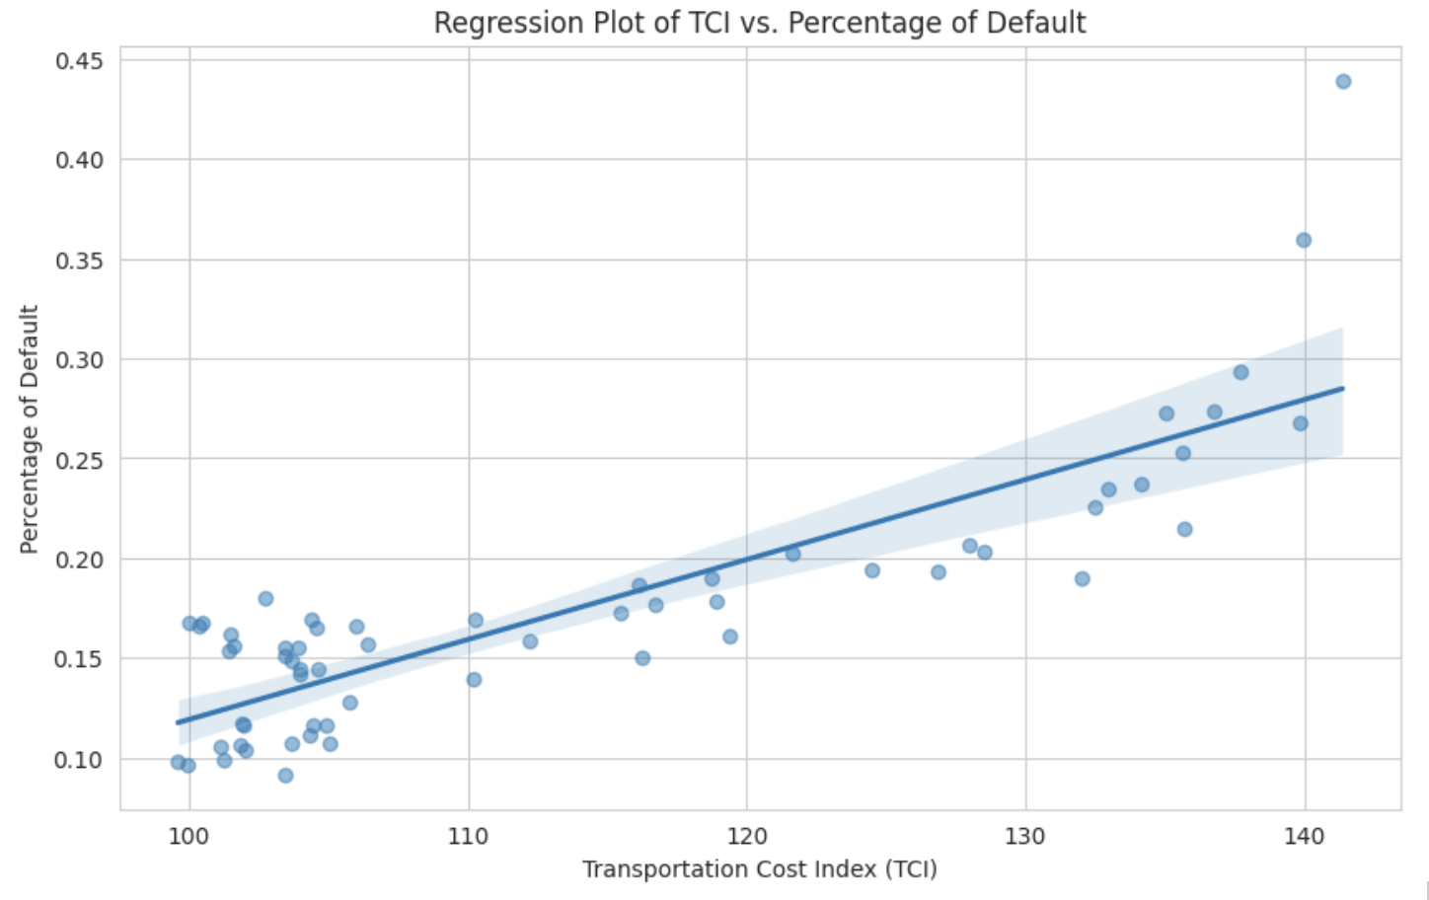
Part 2: Macroeconomic Correlation Analysis
2.1 Univariate Correlation
Models:
Dependent Variable: Default Percentage
Model: Ordinary Least Squares (OLS) Regression
2.1.2 Inflation
Independent Variables | General CPI (monthly) | GDP Deflator (yearly) | Transportation Cost Index (yearly)
Coefficient | Const: -0.2104 (P>|t|=0.000) CPI: 0.0045 (P>|t|=0.000) | Const: 0.0894 (P>|t|=0.000) Deflator: 0.0011 (P>|t|=0.717) | Const: -0.2817 (P>|t|=0.000) TCI: 0.0040 (P>|t|=0.000)
Regression Results | R-squared = 0.543 F-statistic = 212.9 | R-squared = 0.009 F-statistic = 0.1367 | R-squared = 0.718 F-statistic = 147.7
Diagnostic Tests | Durbin-Watson = 0.370 Jarque-Bera = 26368.416 Kurtosis = 60.808 | Durbin-Watson = 0.240 Jarque-Bera = 0.471 Kurtosis = 3.050 | Durbin-Watson = 0.576 Jarque-Bera = 103.466 Kurtosis = 8.389
Pearson Coefficient | 0.737 | 0.095 | 0.847
Similarity:
Coefficients: marginal increase in default rate for increase of CPI and TCI. Statistically Significant.
Model Significance: High F-statistics
Strong Linear Correlation: Pearson Correlation Coefficient between 0.7 and 0.9
Strong Positive Autocorrelation: low Durbin-Watson
Departure from Normality: high Jarque-Bera and kurtosis value
Difference:
TCI: shows a higher explanatory power with R-squared of 0.718. It also has a significantly lower JB score, indicating less extreme non-normality
Notes:
Constant: not meaningful -

Slide 9
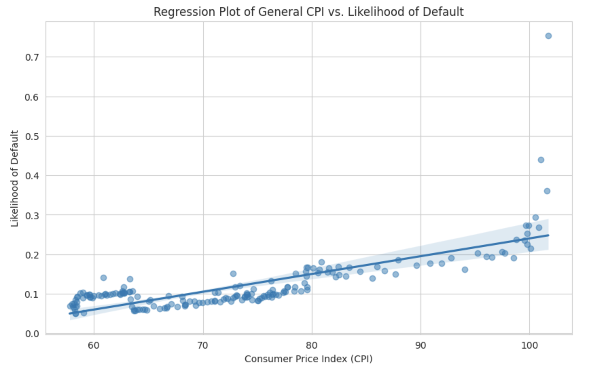
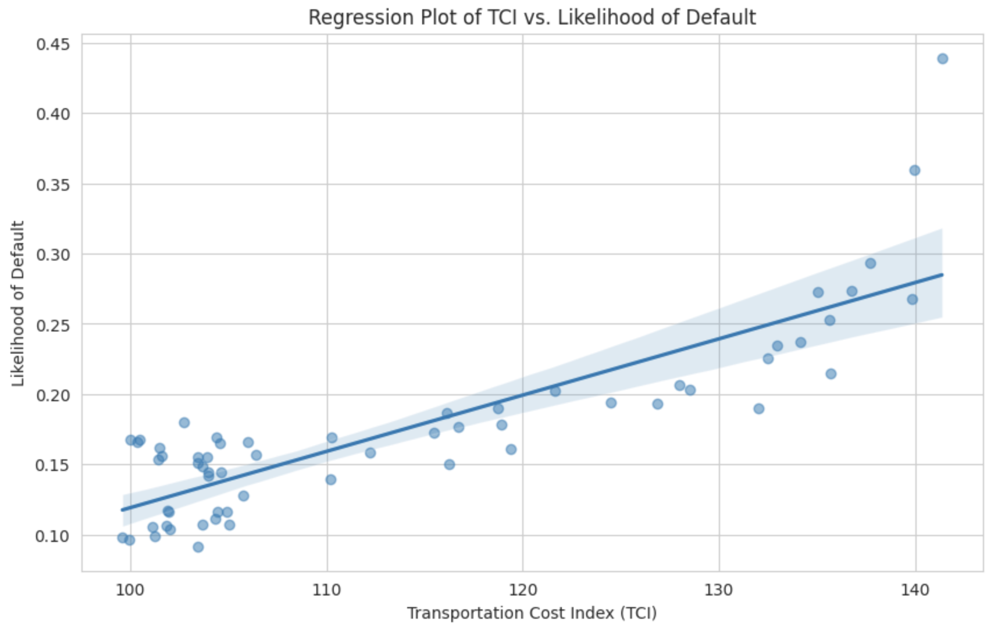
Part 2: Macroeconomic Correlation Analysis
2.2 Univariate Correlation
2.2.2 Inflation (General CPI, GDP Deflator, Transportation Cost Index)
Independent Variables | General CPI (monthly) | TCI (yearly)
Coefficient | (P>|t|=0.000) Statistically Significant | (P>|t|=0.000) Statistically Significant
Regression Results | R-squared = 0.543 F-statistic = 212.9 | R-squared = 0.718 F-statistic = 147.7
Diagnostic Tests | Durbin-Watson = 0.37 JB score = 26368.416 | Durbin-Watson = 0.576 JB score = 103.466
Pearson Correlation | 0.737 | 0.847
Condition Number | 459 | 968
Comment | - Both models show statistical significance, the presence of positive autocorrelation, and significant departure from normality in the residuals. They also both show strong positive linear relationship. - The model of TCI shows a higher explanatory power with R-squared of 0.718. It also has a Durbin-Watson score slightly closer to optimal value of 2, and a significantly lower JB score, indicating less autocorrelation and less extreme non-normality. - The model of General CPI has lower condition number, meaning less potential multicollinearity
Notes:
Constant: not meaningful -

Slide 10
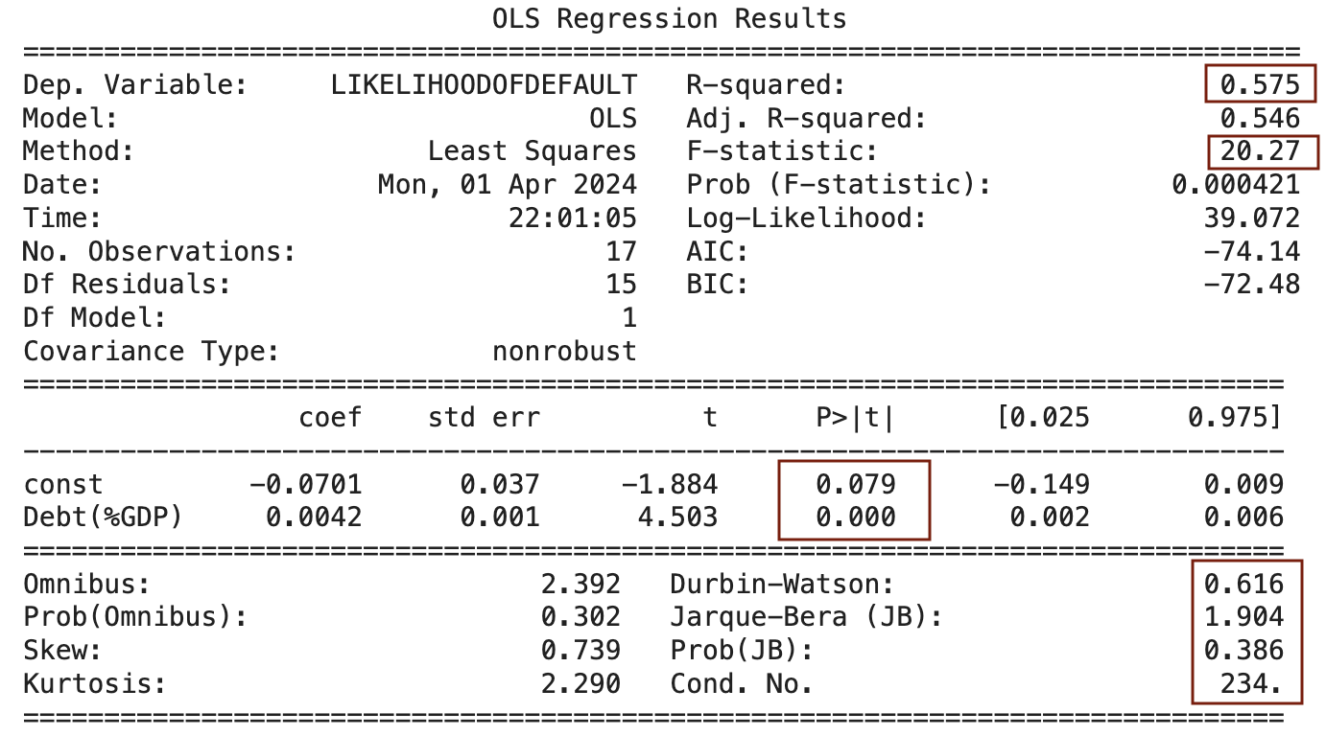
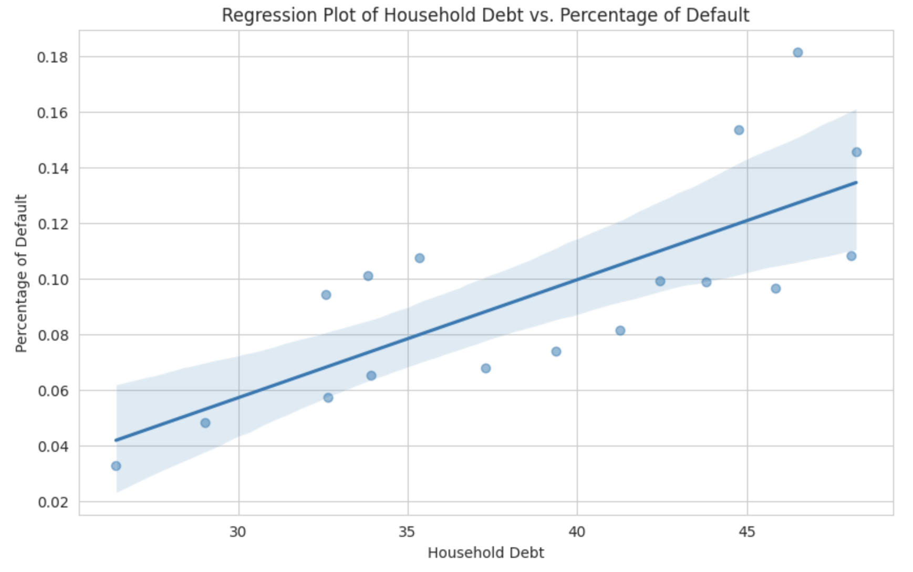
Part 2: Macroeconomic Correlation Analysis
2.1 Univariate Correlation
2.1.3 Household Conditions (Household Debt)
Regression Results:
Moderate Model Fit: R^2(0.575) shows moderate explanatory power
Model Significance: F-statistics of 20.27 indicates the model is statistically significant, confirmed by low Prob(F-Statistics): 0.0004
Strong Linear Correlation: Pearson Correlation Coefficient (0.758)
Household Conditions Model Variables:
Dependent Variable: Yearly Default Percentage
Independent Variables: Household Debt, in %GDP
Model: Ordinary Least Squares (OLS) Regression
Coefficient Interpretation:
Constant: Base level of defaults are zero, so -0.0701 is not meaningful. Close to significance (P>|t|=0.079)
Debt(%GDP): marginal increase in rates of default with increasing household debt. Statistically significant (P>|t|=0.000)
Diagnostic Tests:
Positive Autocorrelation: Durbin-Watson of 0.616 suggests a strong positive autocorrelation
Normally Distributed Residuals: Jarque-Bera of 1.904 nand Kurtosis of 2.290 suggest that the residuals do not significantly deviate from a normality
Notes:
Constant: not meaningful -

Slide 11
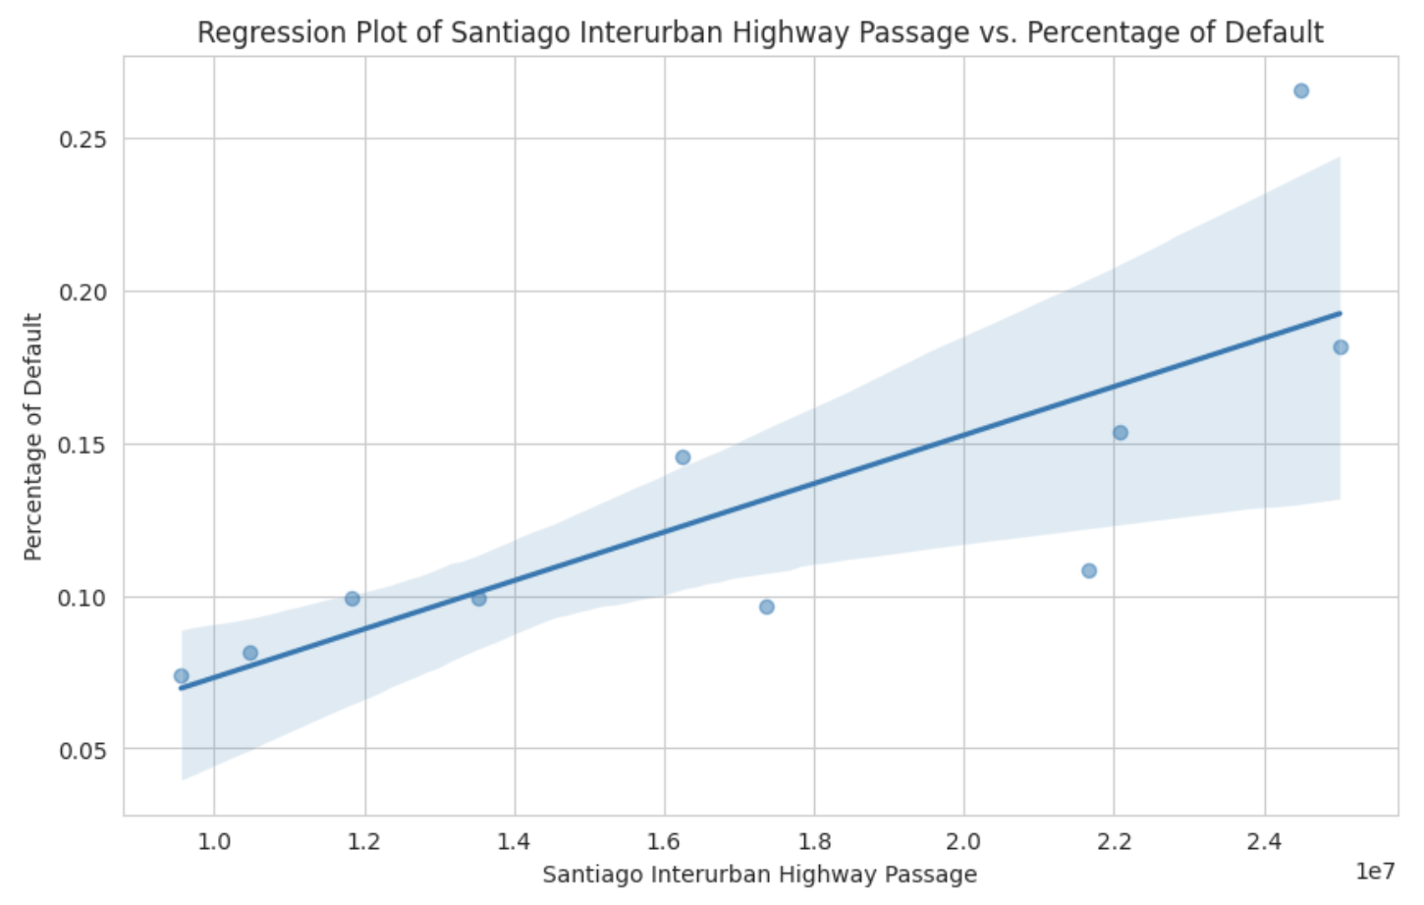
Part 2: Macroeconomic Correlation Analysis
2.1 Univariate Correlation
Models:
Dependent Variable: Yearly Default Percentage
Model: Ordinary Least Squares (OLS) Regression
2.1.4 Urban Transportation
Independent Variables | Passage of Urban Highway (yearly) | Passage of Interurban Highway (yearly)
Coefficients | Const: -0.1462 (P>|t|=0.392) Units: 2.358e-09 (P>|t|=0.123) | Const: -0.0063 (P>|t|=0.878) Units: 7.946e-09 (P>|t|=0.007)
Regression Results | R-squared = 0.270 F-statistic = 2.965 | R-squared = 0.624 F-statistic = 13.25
Diagnostic Tests | Durbin-Watson = 1.041 Jarque-Bera = 1.777 Kurtosis = 2.833 | Durbin-Watson = 1.517 Jarque-Bera = 0.768 Kurtosis = 3.625
Pearson Coefficient | 0.520 | 0.790
Coefficient Interpretation:
Constant: Base level of defaults are zero. Not significant (P>|t|=0.878)
Interurban Highway Passage: marginal increase in default rate with increasing units. Statistically significant (P>|t|=0.007)
Regression Results:
Moderate Model Fit: R^2(0.624)
Model Significance: High F-statistics
Strong Linear Correlation: Pearson Correlation Coefficient between 0.7-0.9
Diagnostic Tests:
Positive Autocorrelation: Durbin-Watson of 1.517 suggests a present but not high positive autocorrelation
Normally Distributed Residuals: small JB score and Kurtosis 0f 3.625 suggest that the residuals do not significantly deviate from a normality
Notes:
Constant: not meaningful -

Slide 12
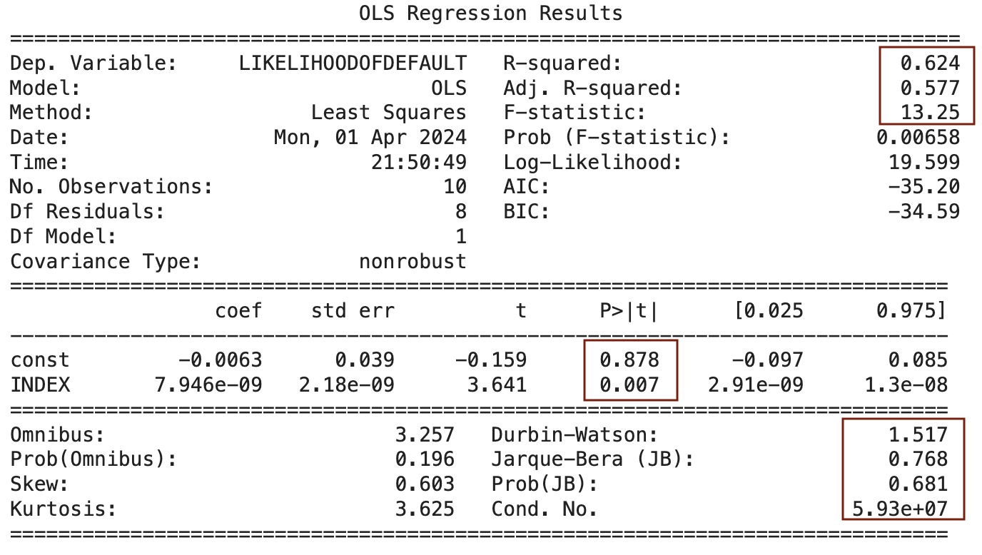
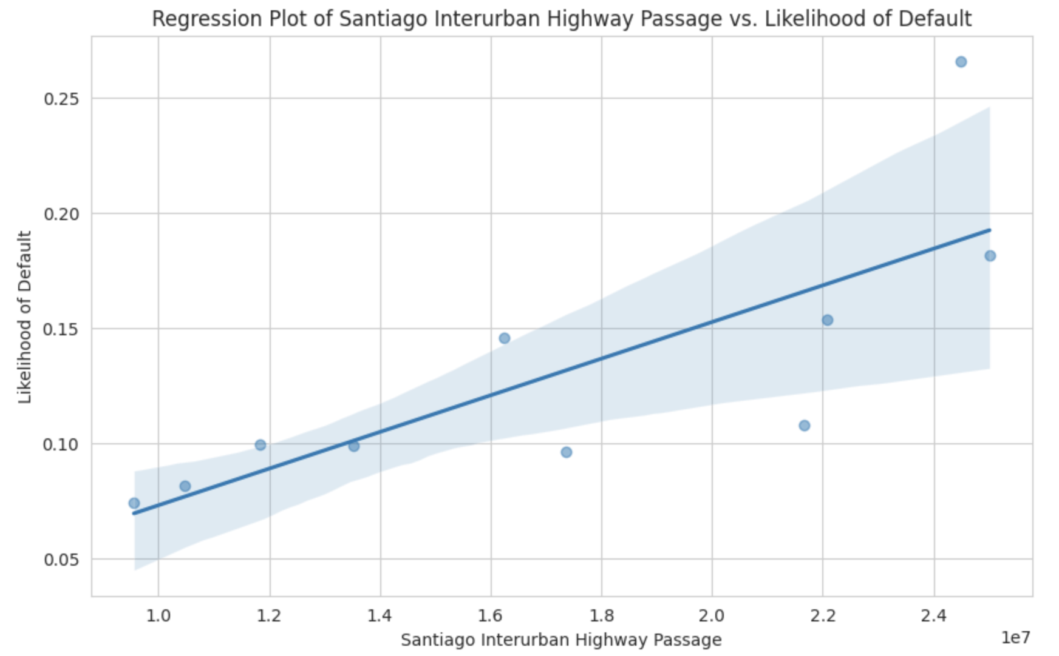
Part 2: Macroeconomic Correlation Analysis
2.1 Univariate Correlation
2.1.4 Urban Transportation (Passage of Urban Highway, Passage of Interurban Highway)
Interurban Highway Model Variables:
Dependent Variable: Yearly Default Percentage
Independent Variables: Passage of Interurban Highway, in units
Model: Ordinary Least Squares (OLS) Regression
Regression Results:
Moderate Model Fit: R^2(0.624) shows moderate explanatory power
Model Significance: F-statistics of 13.25 indicates the model is statistically significant, confirmed by low Prob(F-Statistics): 0.0066
Strong Linear Relationship: Pearson Correlation Coefficient (0.79)
Coefficient Interpretation:
Constant: Base level of defaults are zero, so -0.0063 is not meaningful. Not statistically significance (P>|t|=0.878)
INDEX: marginal increase in rates of default with increasing highway passage. Statistically significant (P>|t|=0.007)
Diagnostic Tests:
Positive Autocorrelation: Durbin-Watson of 1.517 suggests a low positive autocorrelation
Normally Distributed Residuals: Jarque-Bera of 0.768 suggests that the residuals do not significantly deviate from a normality
High Multicollinearity concern: condition number of 5.93e+07 shows significantly high multicollinearity concern
Notes:
Constant: not meaningful -

Slide 13
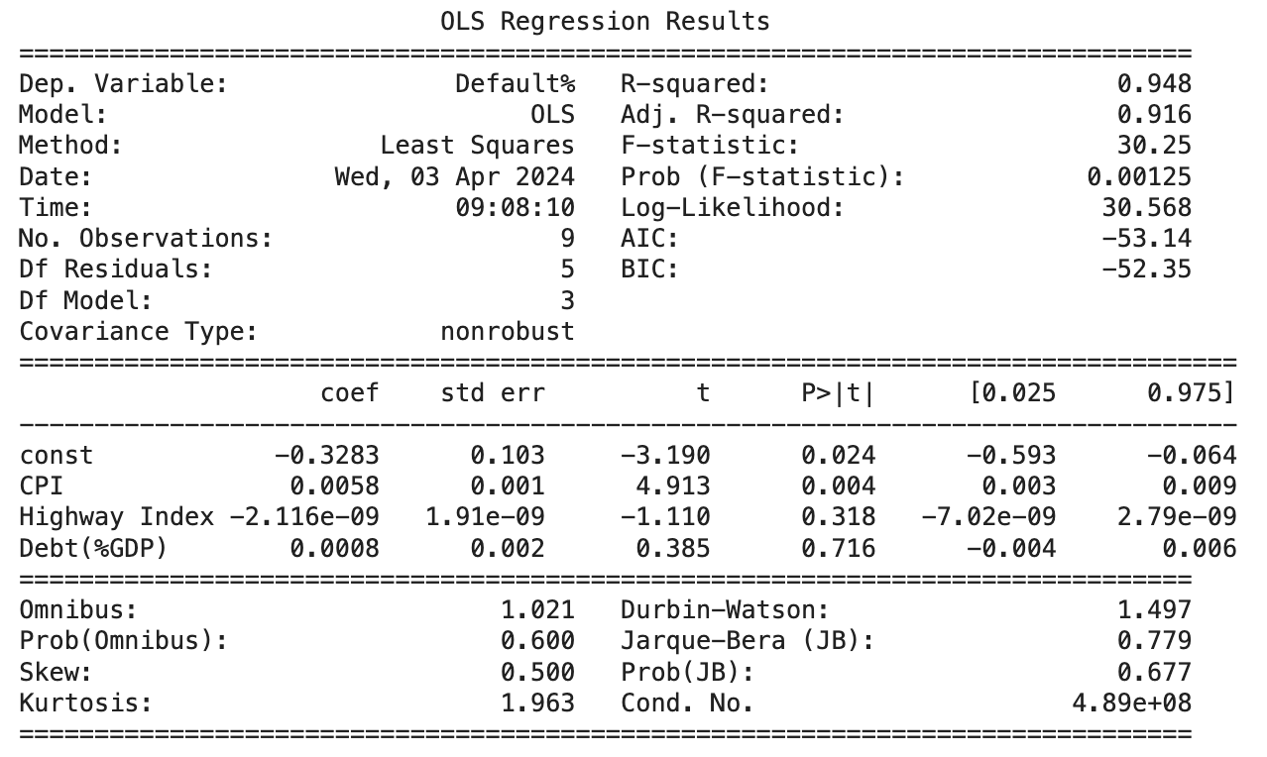
Part 2: Macroeconomic Correlation Analysis
2.2 Multivariate Correlation:
Model Overview:
Dependent Variable: Yearly Default Percentage
Initial Independent Variable Selection:
From each indicator category, selected 1 most statistically significant (if possible)
If multiple significant indicators within category, selected the one with most impact
Santiago GDP, Chilean General CPI, Passage of Interurban Highway, Household Debt
Final Independent Variable Selection:
Accounted for multicollinearity: dropped the variable from with highest Variance Inflation Factor (Santiago GDP)
Chilean General CPI, Passage of Interurban Highway, Household Debt
Model: Ordinary Least Squares (OLS) Regression
Model Results:
Statistical Tests:
Adjusted R-squared (0.916): The model explains a significant portion (91.6%) of the variance in default rates.
F-statistic (30.25): Shows strong overall significance of the model, with Prob (F-statistic) of 0.00125 confirming this.
Durbin-Watson (1.497): Indicates there might be a slight autocorrelation in the residuals, but generally close to acceptable.
Jarque-Bera Test: Suggests that the residuals are approximately normally distributed (Prob(JB) = 0.677).

Slide 14
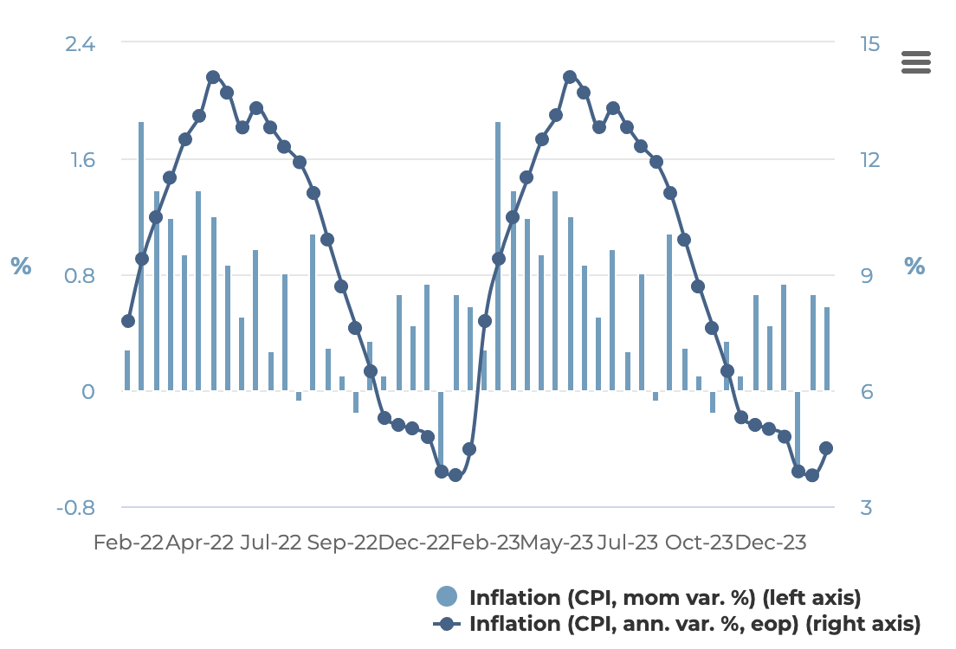
Part 2: Macroeconomic Correlation Analysis
2.2 Multivariate Correlation
Coefficient Analysis:
Constant (-0.3283): Statistically significant (P>|t|=0.024), with a negative value suggesting a base level of default below zero.
CPI (0.0058): Statistically significant (P>|t|=0.004), with a positive coefficient indicating an increase in toll defaults with an increase in Chilean General CPI.
Economic Significance: High inflation volatility and rates in Chile.
Discrepancy between CPI coefficients in univariate (0.0045) and multivariate (0.0058) regressions is very slight.
Possible reasons include:
Dataset Timeline and Granularity
Influence of other Variables.
Interurban Highway Passage (-2.116e-09): Not statistically significant (P>|t|=0.318).
Household Debt(%GDP) (0.0008): Not statistically significant (P>|t|=0.716).
Chilean Inflation Rates (CPI)
Source: National Institute of Statistics of Chile

Slide 15
Part 2: Macroeconomic Correlation Analysis
Increasing Model Complexity:
Objective and Approach To explore non-linear relationships and interaction effects.Implement Polynomial Regression for non-linear trends, and test interaction terms between significant variables.
Expected Outcome: A more nuanced understanding of the relationships between variables.
Conducting Segmentation Analysis:
Objective and Approach: To identify variations in toll payment defaults between different consumer segments.Segment data by consumer characteristics, and perform correlation analysis on each segment.
Expected Outcome: Insights into sector-specific impacts.
Implementing Time-Series Analysis:
Objective and Approach: To account for temporal trends and seasonal effects. Utilize Autoregressive Integrated Moving Average (ARIMA) or similar models, and include lag variables to capture time-based dependencies.
Expected Outcome: Enhanced model accuracy considering time dynamics.
Robustness Checks:
Objective and Approach: To validate the reliability of the model results.Conduct out-of-sample testing, and perform cross-validation for model assessment.
Expected Outcome: Confirmation of the model's predictive power and generalizability.
2.2 Multivariate Correlation
Next Steps for Multivariate Correlation Analysis
Increasing Data Granularity:
Objective and Approach: Expand the dataset to increase the number of observations.Shift from yearly to quarterly or monthly data aggregation.
Expected Outcome: More reliable statistical inference.
Exploring Additional Economic Variables:
Objective and Approach: To capture a broader spectrum of factors that might influence toll payment behaviors.Potential Variables include Interest Rates, Unemployment Rates, Consumer Confidence Index.
Expected Outcome: Uncover more nuanced relationships and potential predictors.
Addressing Multicollinearity:
Objective and Approach: To ensure the independence of predictor variables.Use Variance Inflation Factor (VIF) analysis to identify multicollinearity, and consider removing or combining highly correlated variables.
Expected Outcome: Improved model accuracy and reliability of coefficient estimates.

Slide 16
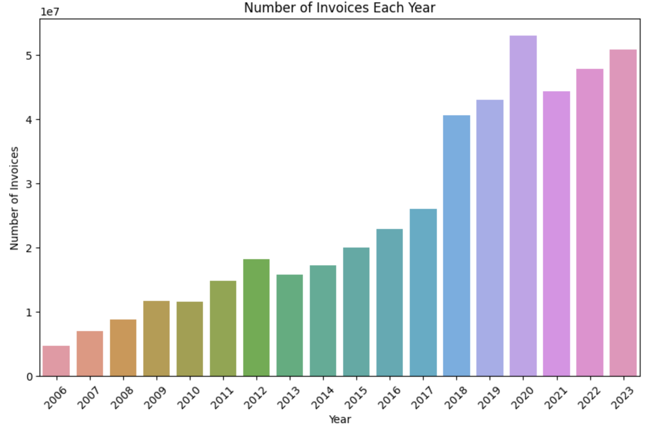
Part 3: Predictive Model: Data EDA
The dataset has around 11% Unpaid invoice information which combines both Impaga(Unpaid) and Castigado (Cancelled) invoices. The remainder of 89% are Pagada (Paid) transactions which also include delayed payments.
The graph below shows the an increasing trend of invoice generation over the years as more number of people have cars and use the toll roads
*Invoices generated in 2024 have been excluded from the graphs due to limited data for the year
3.1 Vespucio Data
Overview
Vespucio Data is 482M records with 39 columns
Time period: 2006-2024
Equifax Data for Chilean citizens is 3M records with 7 columns
We have combined the two datasets using the Chilean Unique Identifier(RUT) to form a consolidated dataset that provides information about billing documents, which include data points of clients and vehicles, as well as invoice and payment details such as invoice dates, payment dues, payment statuses, transaction amounts, transaction generation types and customer credibility.
Through this Exploratory Data Analysis, our goal is to understand the status quo. Some questions the EDA can answer:
Q. How has the collection rate changed over years? Q. How has the on-time payments rate changed over years? Q. Does client_type/vehicle category affect payments?
Q. What are the existing relationship patterns between our attributes of concern (DiasCompensacion- the days difference between the payment date and the due date, ImportePesos- transaction amount) and other variables in the dataset

Slide 17
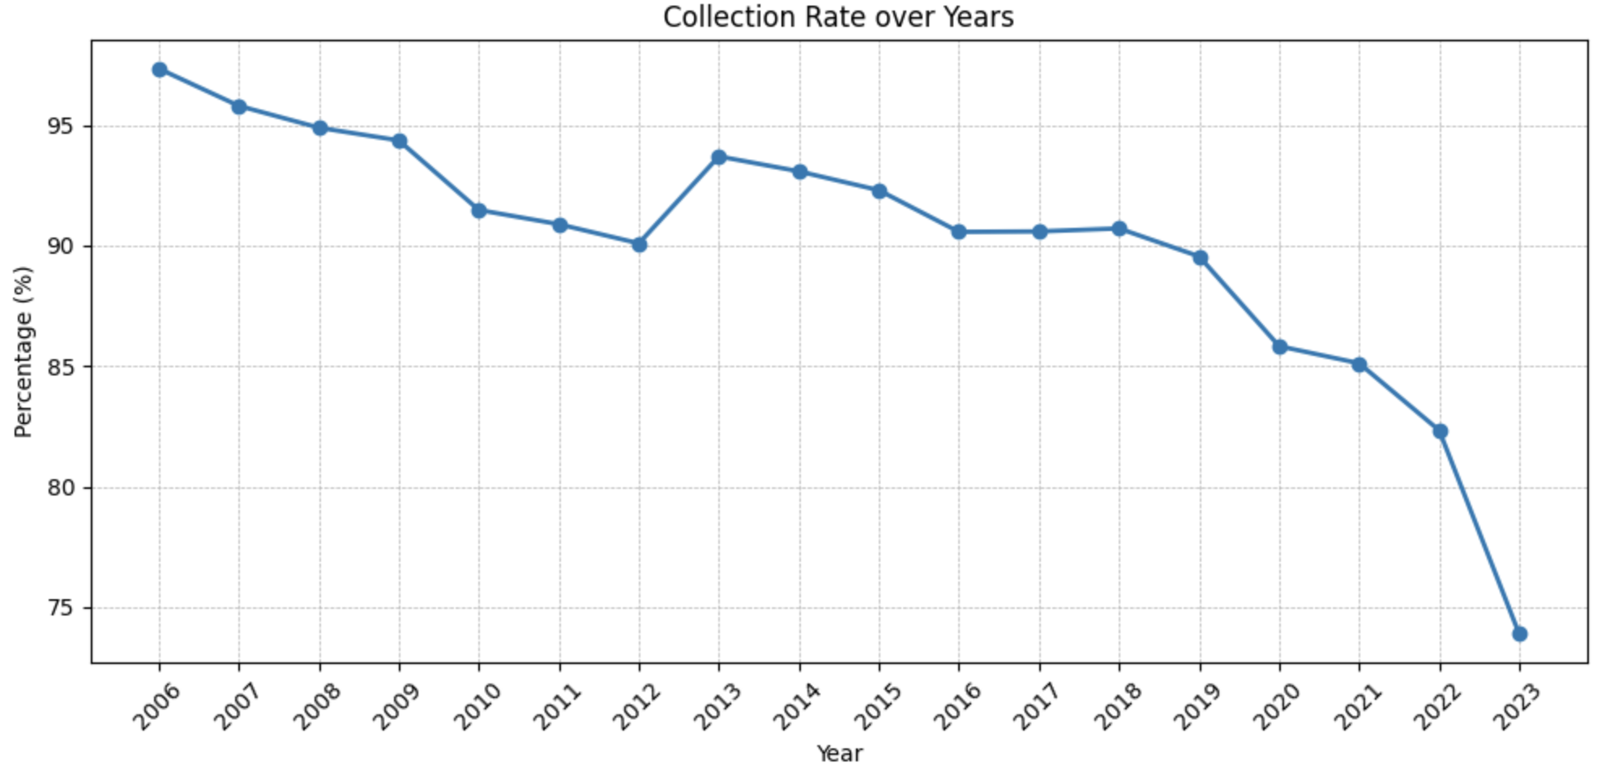
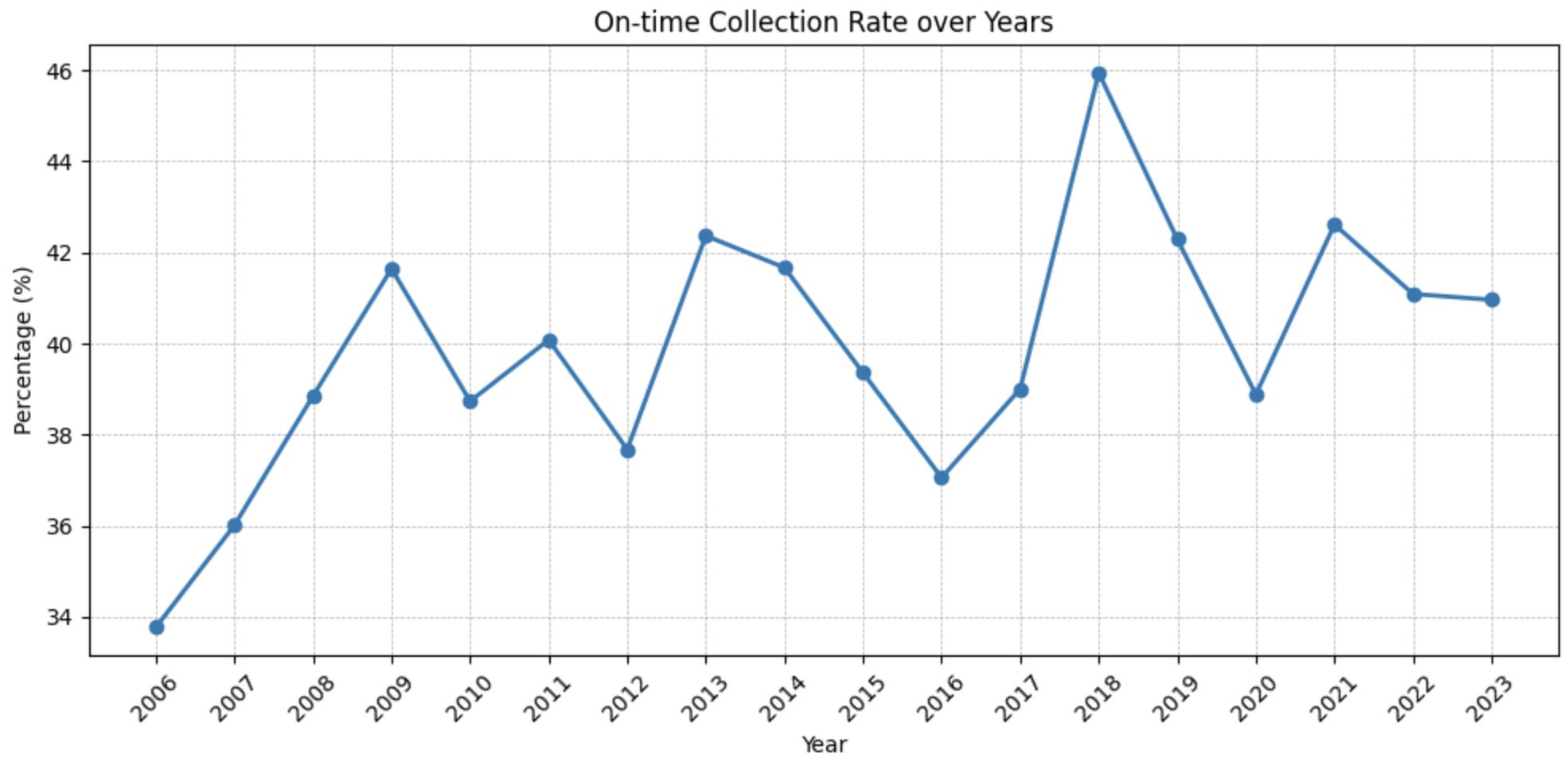
Part 3: Predictive Model: Data EDA
3.1 Vespucio Data
Overview
Collection Rate over years
On-time collection rate over years (Paid within 30 days)
Inference after running for entire dataset
Collection rate (Paid invoices) over years
We can observe that the Collection Rate (% Pagda) has downward trajectory and between 2006-2023 has fallen by over 20%
We can observe that the On-time Collection Rate (% payments made within 30 days) is a bumpy graph and fluctuates year over year suggesting high variability with no clear pattern

Slide 18
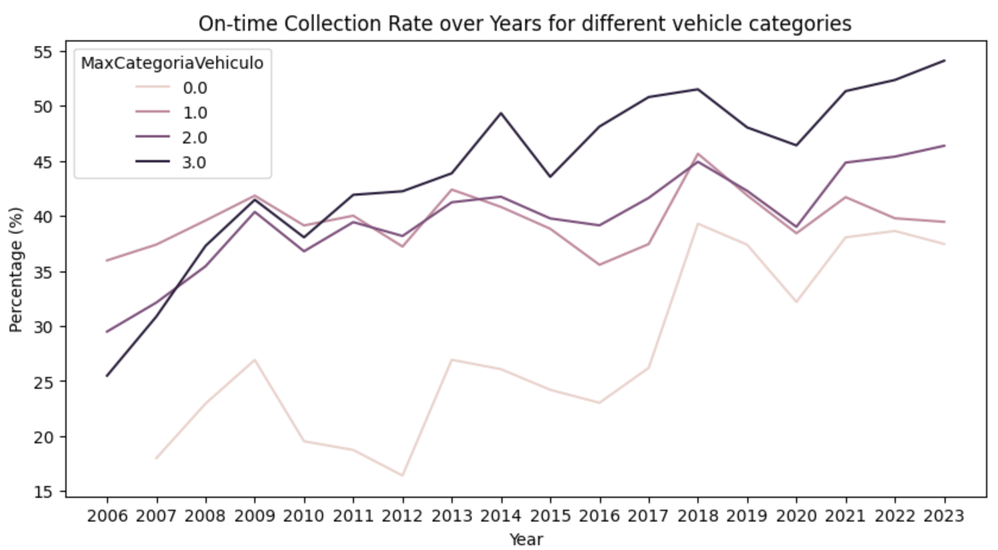
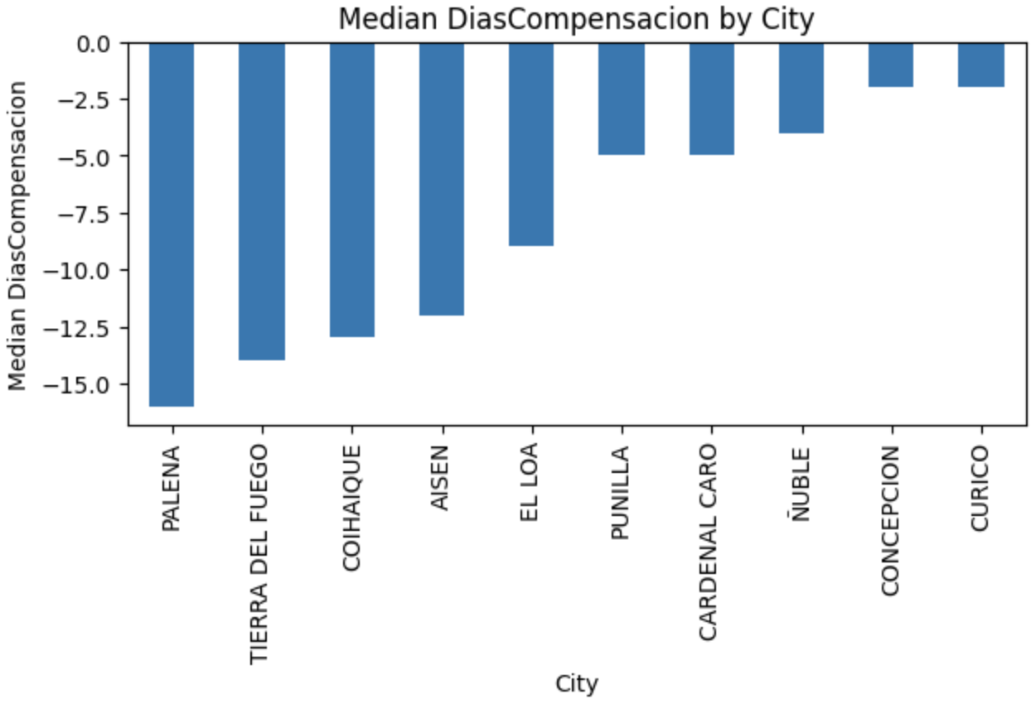
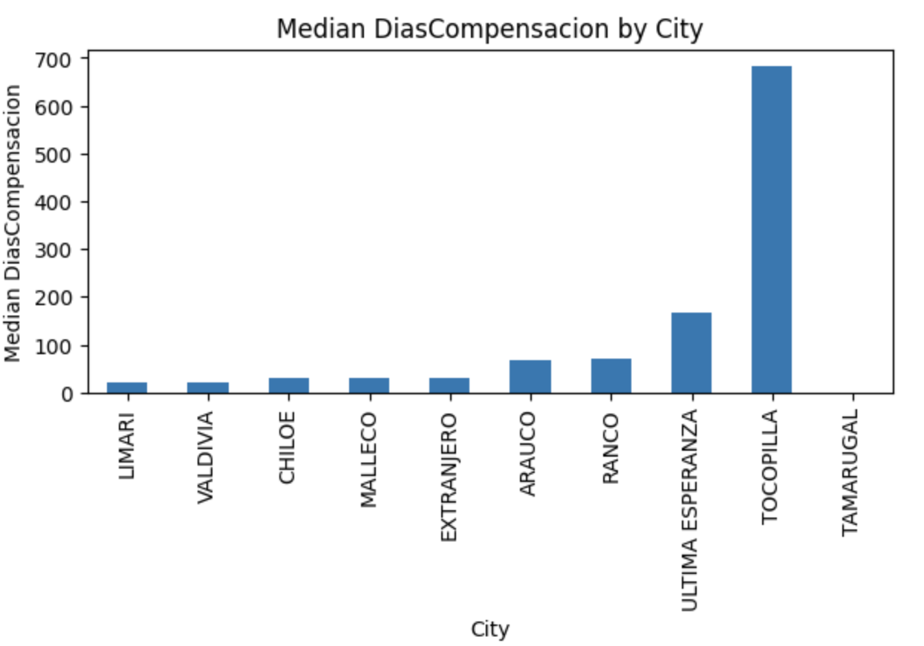
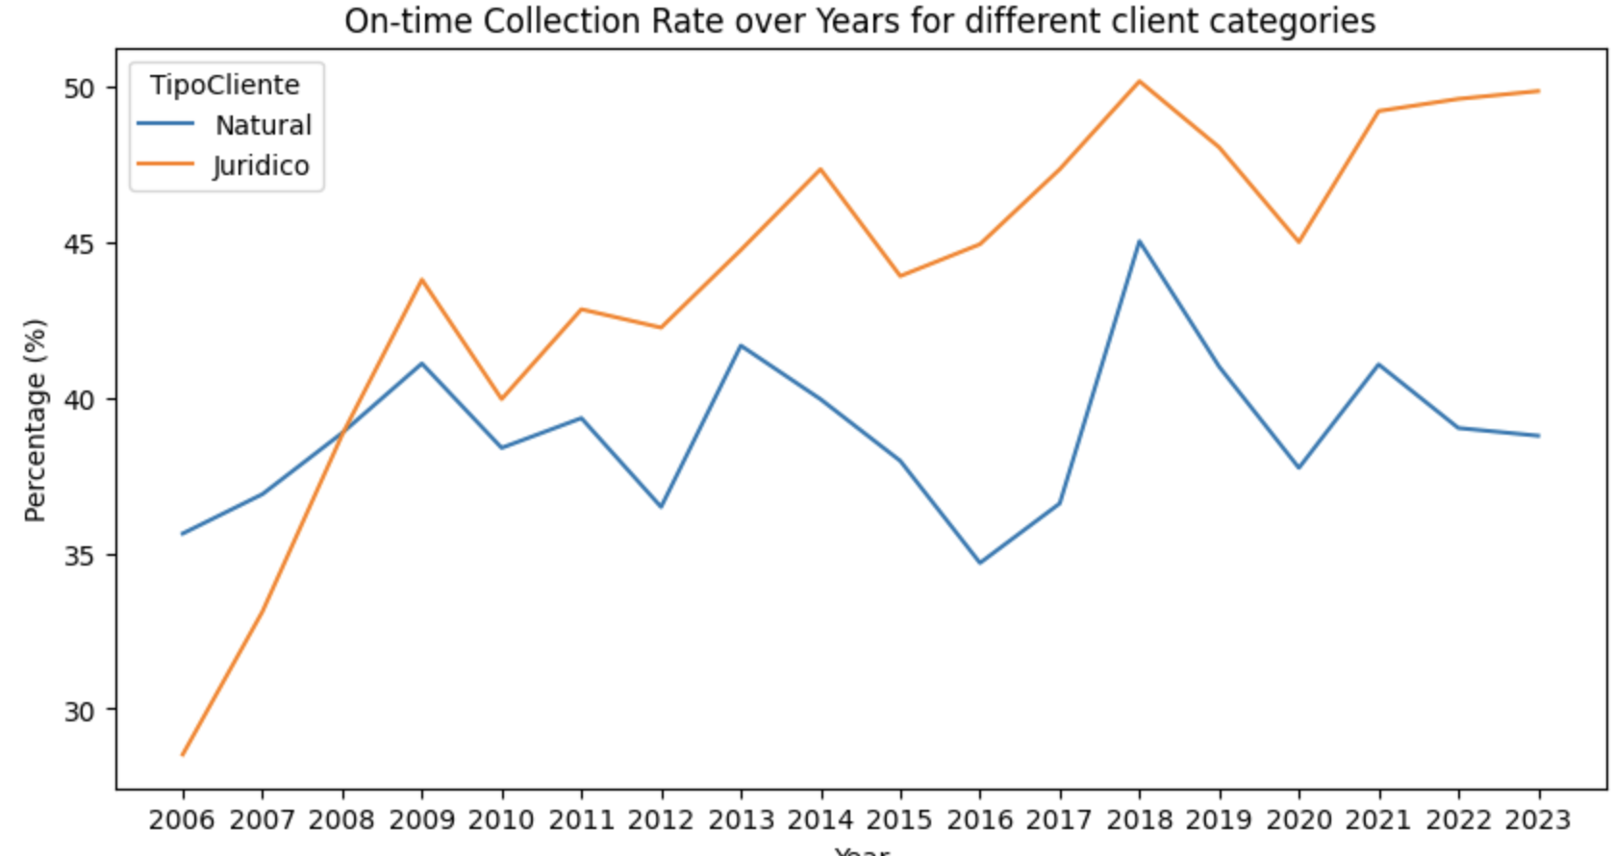
Part 3: Predictive Model: Data EDA
On-time collection rate over years with Vehicle Categories
3.1 Vespucio Data
Median DiasCompensacion by City
Top 10 Resident Cities with the lowest payment gap. Generally all payments within the due date
We can clearly observe that as the Vehicle Category goes up the collection rate goes up. This may mean that heavy duty vehicles pay regularly as compared to light/medium
Motor vehicles
Worst 10 Resident Cities with the highest trend of payment delays
On-time collection rate over years for diff client types
Collection rate (Paid invoices) over years
Legal Entities are way more likely to pay on time than Individuals. 20% of our transactions are from legal entities

Slide 19
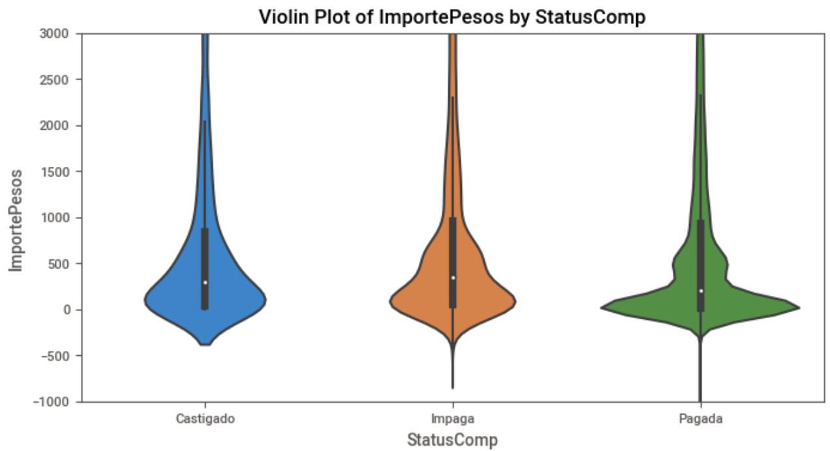
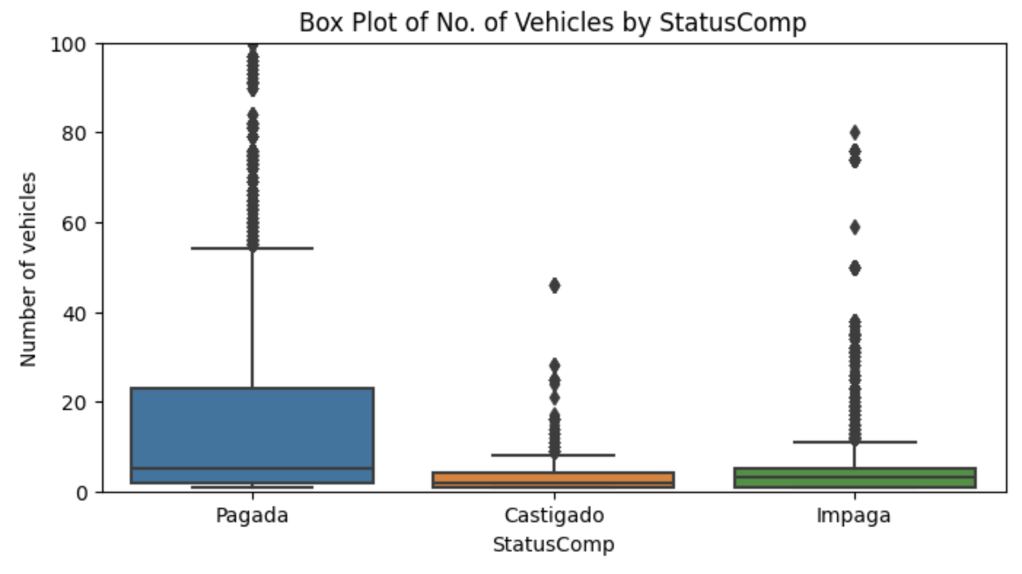
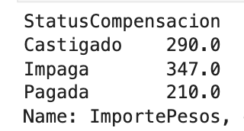
Part 3: Predictive Model: Data EDA
3.1 Vespucio Data
Overview
Distribution of DiasCompenscion w.r.t Payment Status
Distribution of Number of Vehicles w.r.t Payment Status
On-time collection rate over years for diff client types
Paid invoices have a 39% lower median transaction amount
It can be observed that clients with multiple vehicles have a higher chance of not defaulting on payments

Slide 20
Part 3: Predictive Model: Data EDA | 3.2 Equifax Score Data
3.2.1 Background information and basic assumption
Equifax gives credit scores to companies and individuals
Equifax is a global data, analytics, and technology company known for providing information solutions and analytics to businesses and consumers. In Chile, Equifax operates as a credit reporting agency, offering credit information and risk management services to financial institutions, businesses, and consumers. The score is usually between 280 to 850, and the basic interpretation is as follows:
Higher Equifax score should suggest better payment behavior
Our key assumption for exploring with the Equifax score is that individuals with a higher Equifax score should be a more motivated payer. By saying that, we expect individuals with higher Equifax scores to have a higher probability of making payment (or, individuals making the payment should tend to have a higher score than individuals who don’t), to have a shorter delay in making payments, and to make a larger amount of payment.
To justify our assumptions, we first carried out EDA on the consolidated dataset, so as to visualize the pattern of the relationships between Equifax score and the variables we care about. If the pattern generally coincides with our assumption, we will then further carry out tests to quantify the relationship.
300 - 579 | POOR
580-669 | FAIR
670-739 | GOOD
740-799 | VERY GOOD
800+ | EXCELLENT
Notes:
For our dataset, the majority of the scores lie between 200 to 800, which covers from underperformed to very good. The equifax score is evaluated based on individuals’ Payment History,Credit Utilization, Length of Credit History, Types of Credit, and many other factors.

Slide 21
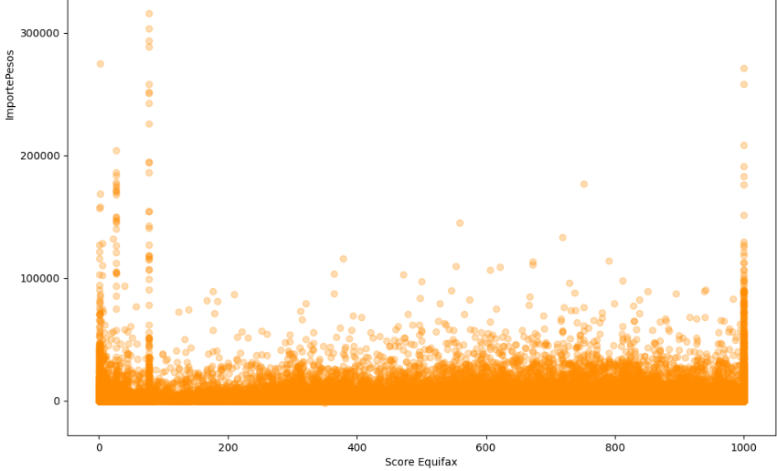
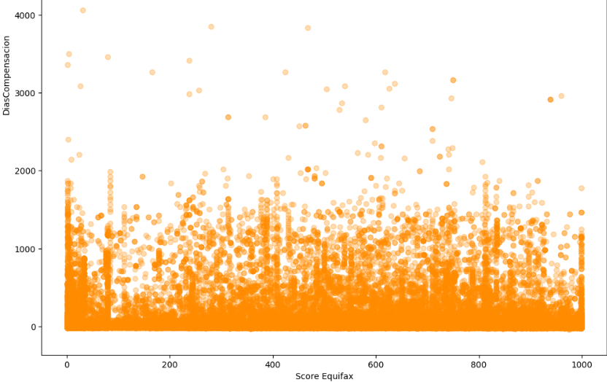
Part 3: Predictive Model: Data EDA | 3.2 Equifax Score Data
3.2.2 Initial Exploration and Visualization
Equifax Score vs ImportePesos
Equifax Score vs DiasCompensacion
ImportePesos is the variable recording the transaction amount. Unlike what we have expected, the relationship between the ImportePesos and the Equifax Score doesn’t seem to be significant.
DiasCompensacion is the variable showing the difference between the due date and the payment date. As shown in the graph, there isn’t a significant relationship, and for each Equifax score, the DiasCompensacion has shown a similar pattern.
Notes:
mportePesos is the variable recording the transaction amount. Unlike what we have expected, the relationship between the ImportePesos and the Equifax Score doesn’t seem to be significant. For each Equifax Score, the transaction amount covers a similar range, while the majority of transactions locate below 25000 pesos. According to tollguru.com, a website specified for calculating the toll fee in Chile, a five-hour drive covering 500 km will cost around 20000 pesos. Thus, the currently shown pattern is reasonable, as the most common driving courses in Peru is within 5 hours.
DiasCompensacion is the variable showing the difference between the due date and the payment date. As shown in the graph, there again isn’t a significant relationship. Unlike what we would have expected, for each Equifax score, the DiasCompensacion has shown a similar pattern, which is majorly covering a range from 0 to nearly 2000, while mostly concentrating in number of days below 400. A possible explanation for this phenomenon is that the DiasCompensacion is only recorded for individuals who have actually made payment, and for those who make payments, they tend to finish the payment within a year regardless of their Equifax score.

Slide 22
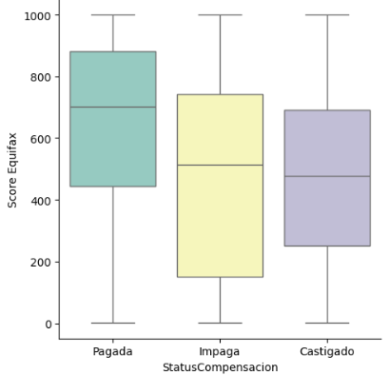
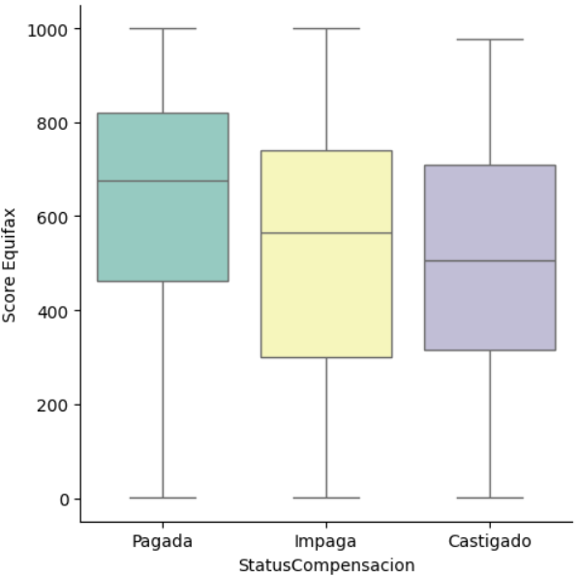
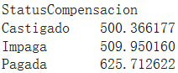
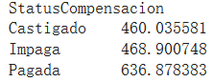
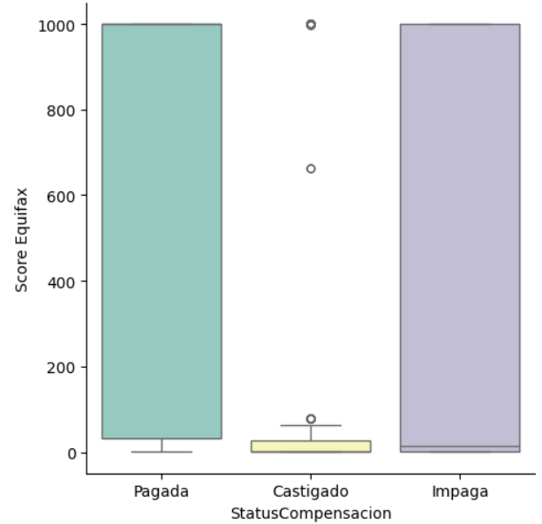
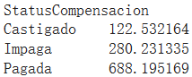
Part 3: Predictive Model: Data EDA | 3.2 Equifax Score Data
3.2.2 Initial Exploration and Visualization
Equifax Score vs Status Compensacion
Natural Individuals
Legal Individuals
Status Compensacion is the variable recording the payment status, which includes Pagada(paid), Impaga(unpaid), and Castigado(unpaid write-off). From the boxplot, we can tell that the Pagada group has an apparently higher median than other two groups, and the range is generally higher as well. Taking a closer look into the group mean, we noticed that the Pagada group has a significantly higher average Equifax score than the other two groups.
Notes:
According to the chart of categorizing the score level mentioned before, the average score of Pagada belongs to the upper range of the Fair credibility level, and the average of other two groups both fall into the poor level. All these findings coincide with our initial hypothesis, that individuals making payment should have a higher Equifax score than those who don’t, and thus we wish to further quantify the relationship between Equifax Score and Status Compensacion.
Meanwhile, we noticed that the samples are divided into two groups of individuals, which are natural individuals, the common public, and the legal individuals, the firms and companies. The Equifax score may be evaluated differently for these two groups, thus we further explored the relationship between Equifax score and Status Compensacion within each group. On the right, you can see there indeed is a different pattern between Group Natural and Group Legal. For the natural individuals, the pattern is more similar to the general trend, which is reasonable as more than 70% of all samples consist of the natural individuals. For the legal individuals, the result is more interesting, as the distinction of the score among the three types is more significant. As you can see, the average score of Pagada is 688, while for Impaga is just 280, and merely 122 for Castigado. Thus, we may also conclude that legal individuals are following our assumptions better than natural individuals.

Slide 23
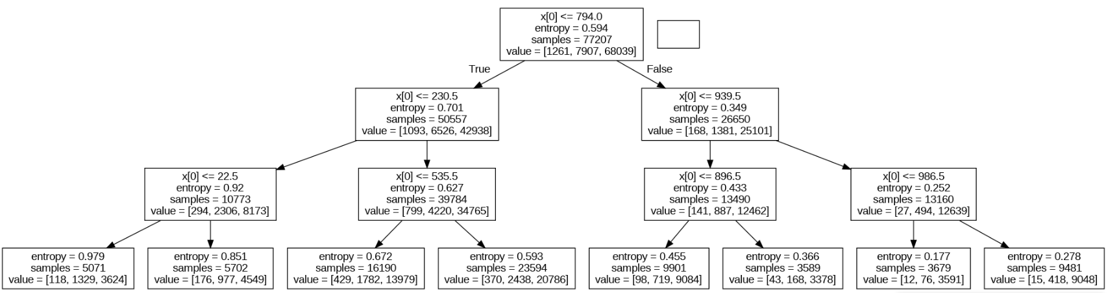
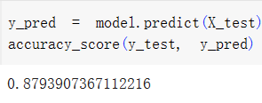
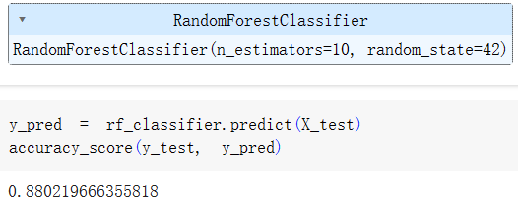
Part 3: Predictive Model: Data EDA | 3.2 Equifax Score Data
3.2.3 Quantitative Analysis on Equifax Score vs Status Compensacion
Decision
Tree
Classifier
Given that the Status Compensacion is a categorical variable and has more two categories, here we consider to use the tree decision models to quantitatively explore the relationship between Equifax Score and Status Compensacion. As shown, the accuracy scores for both decision tree and random forest are around 0.88, suggesting that the relationship does not only exist, but is strong and useful for predicting payment behavior.
Random
Forest
Classifier
Notes:
Given that the relationships between Equifax score and payment delay and payment amount are both insignificant, we decided to just carry out further tests on Status Compensacion.
However, indeed when there is only one variable the decision tree model will not be very reasonable, but still, we have confirmed the predictive ability of Equifax score on status compensacion, and in the future, we will continue using the decision tree model as the core model, while adding more variables to it.

